Slide 1
How to Use
Genesis Grant
CTEC402
ChatGPT and OpenAI Platforms & Windows 11

Slide 2
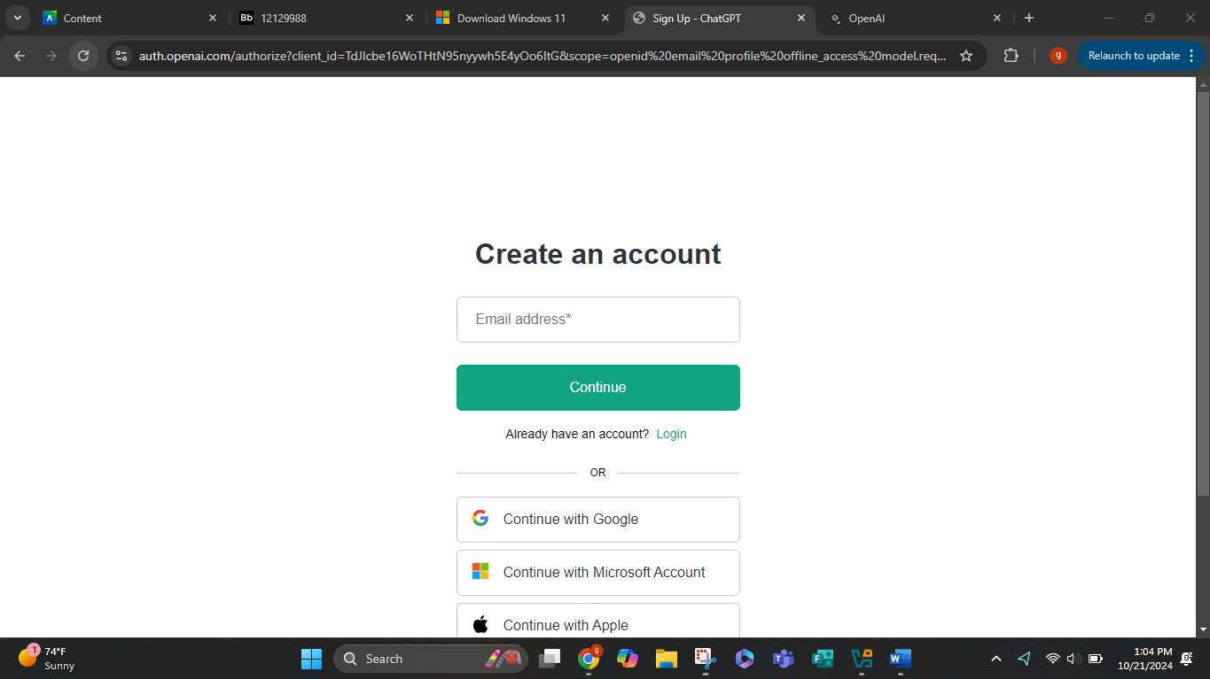
Go to https://chatgpt.com/

Slide 3
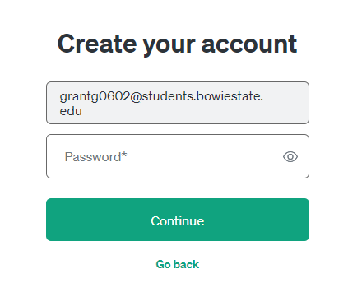
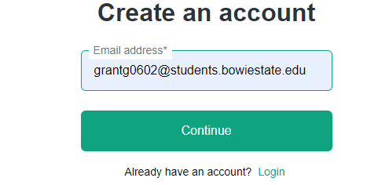
Enter email and password you want associated with the account

Slide 4
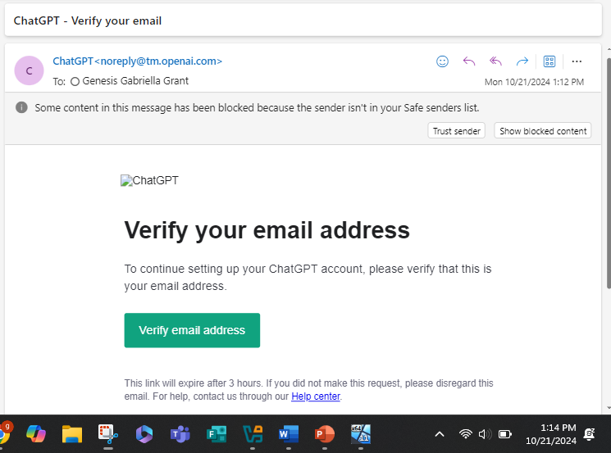
Verify yourself

Slide 5
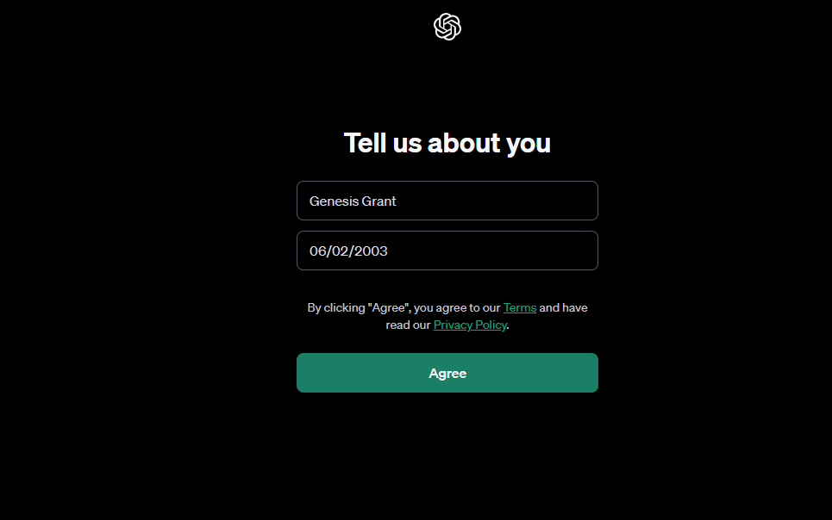
Input necessary information

Slide 6
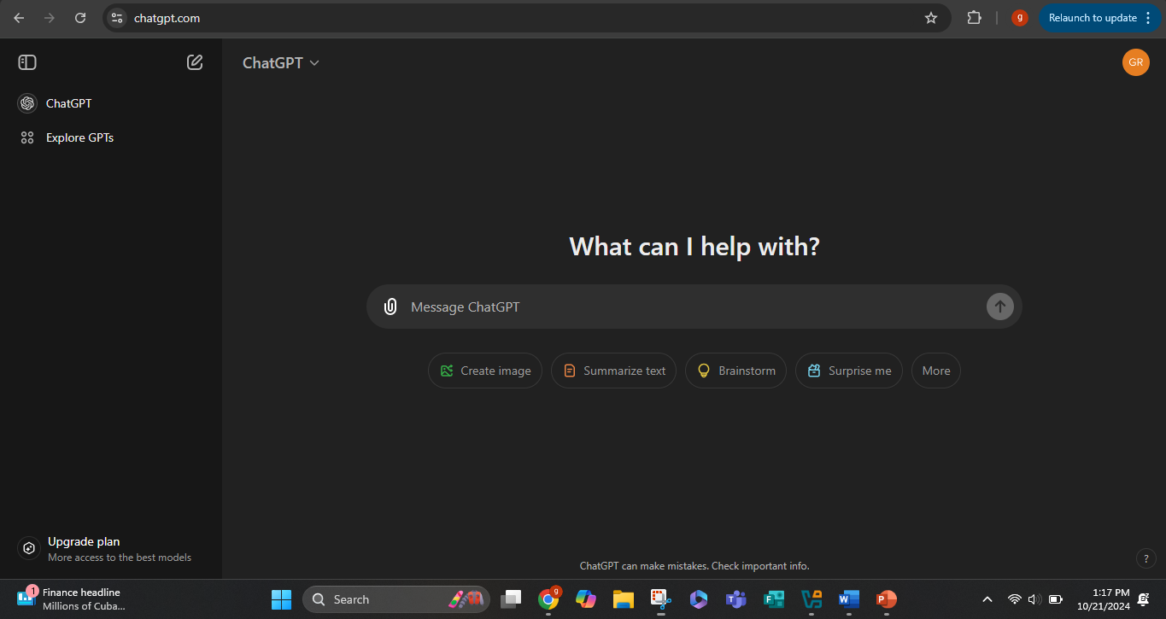
Begin using chatgpt

Slide 7
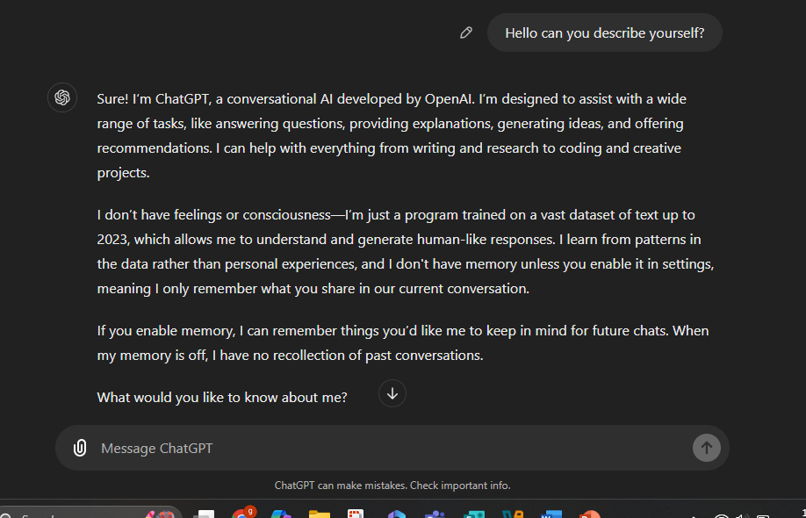
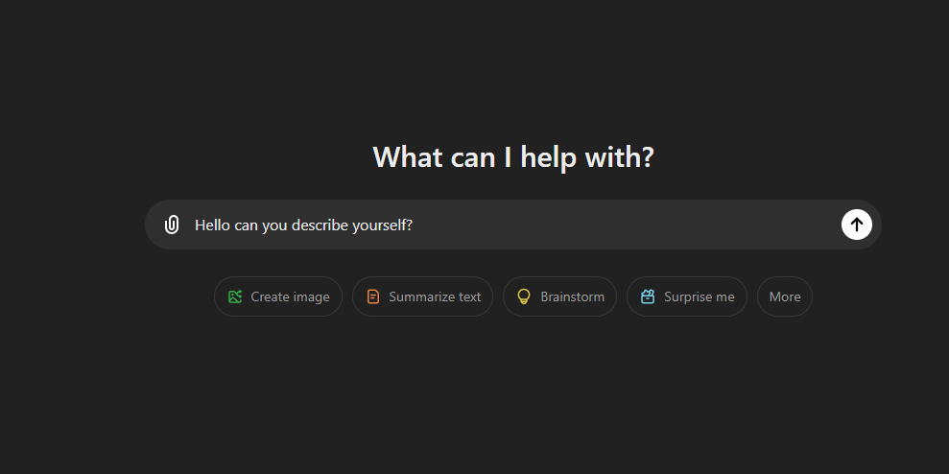
Type a question and receive a response once sent

Slide 8
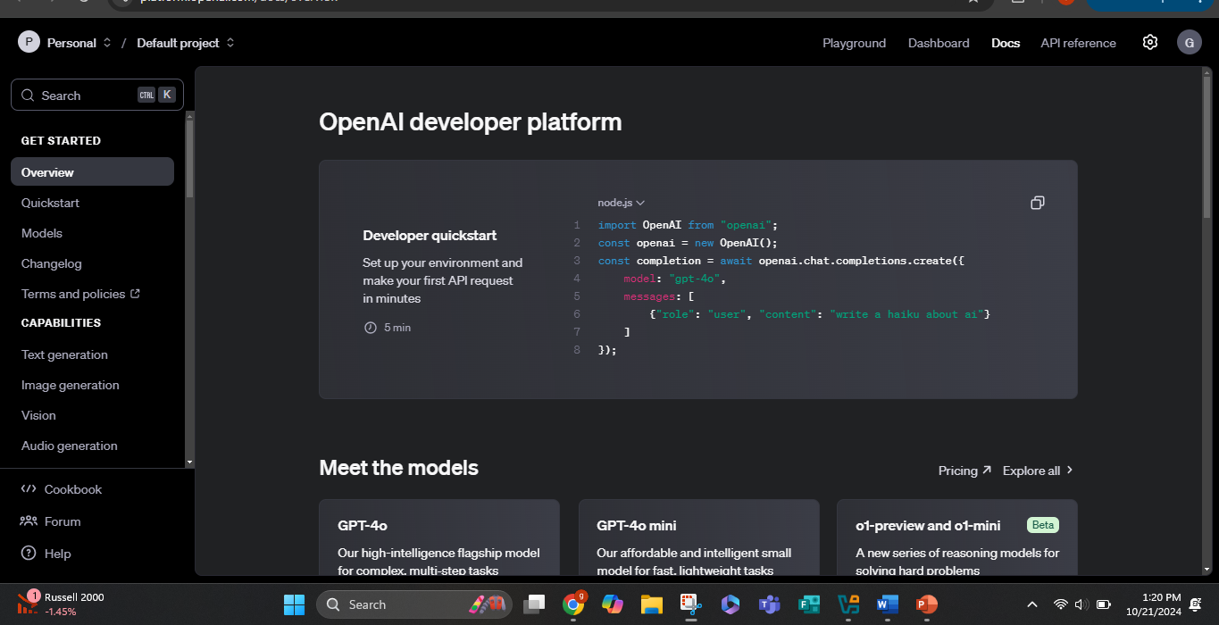
Go to https://platform.openai.com/docs/overview This provides more information about OpenAI developer tools and models.

Slide 9
How to
Install Windows 11

Slide 10
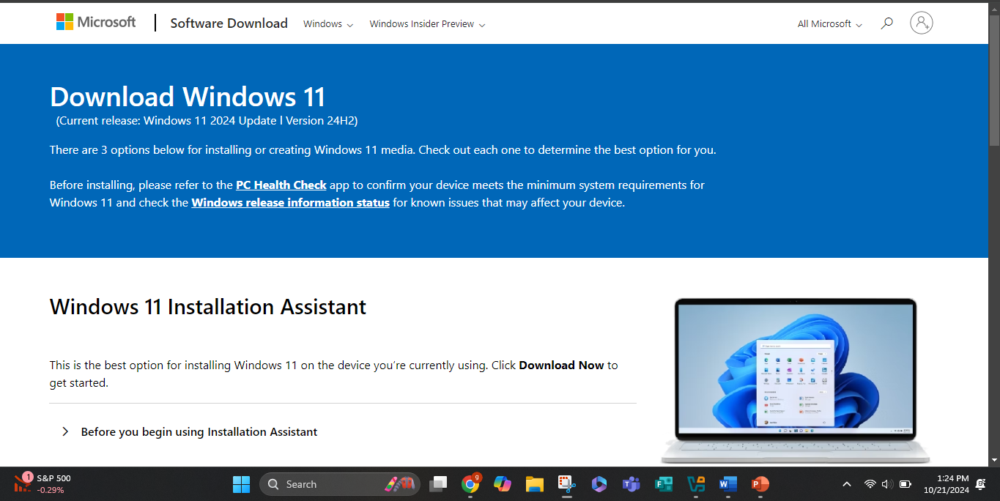
Go to this link

Slide 11
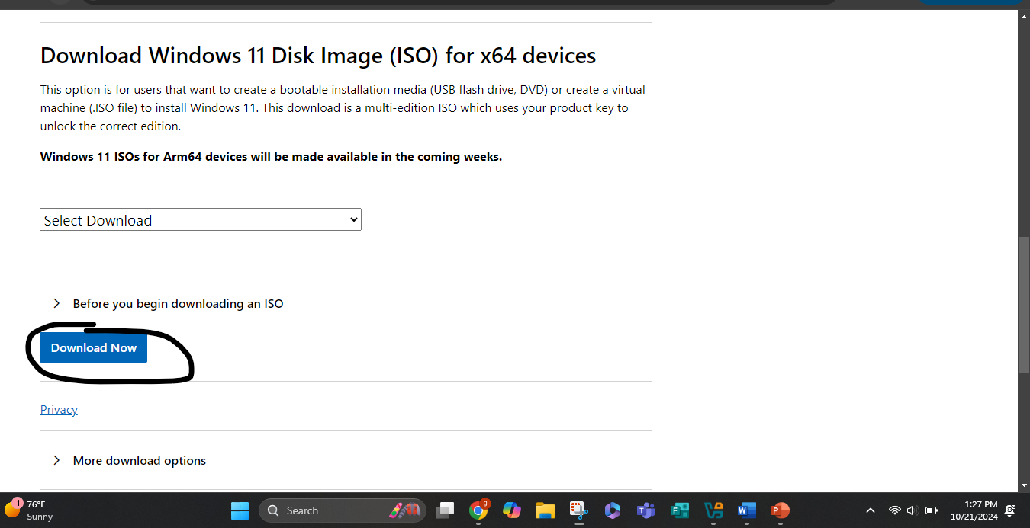
Scroll down and download the ISO image

Slide 12
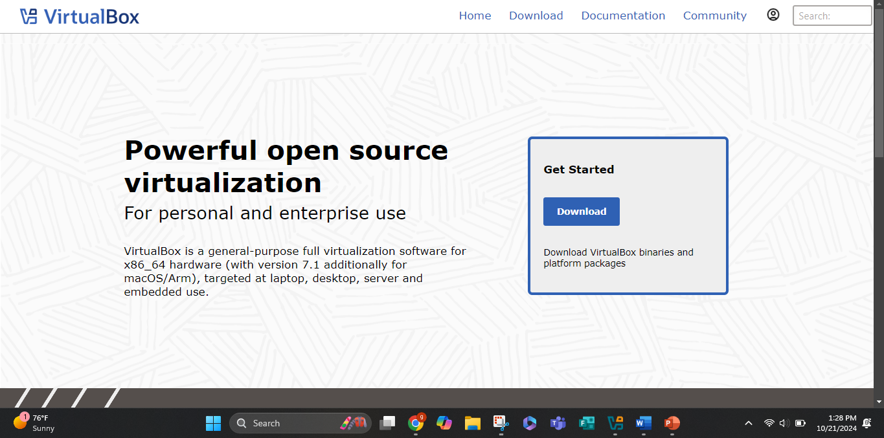
Download Oracle VirtualBox to begin using windows 11 on a virtual machine

Slide 13
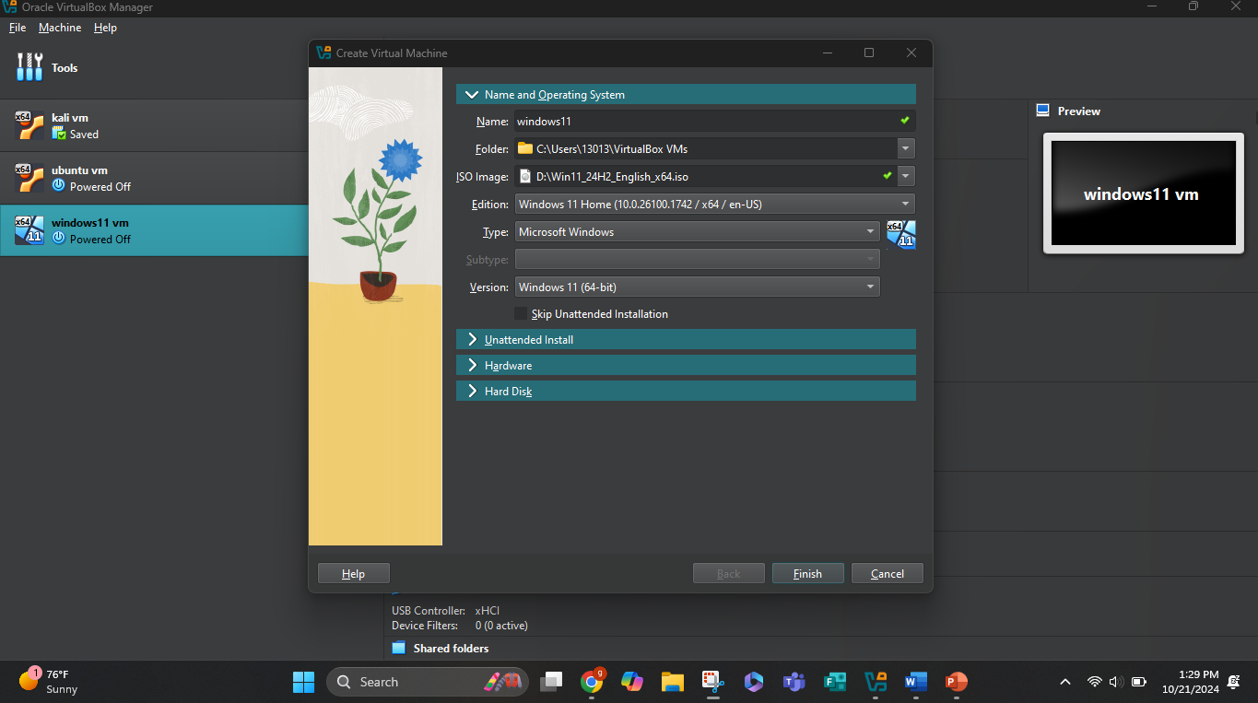
Using virtualBox upload iso image and create virtual machine for windows 11

